Slide 1
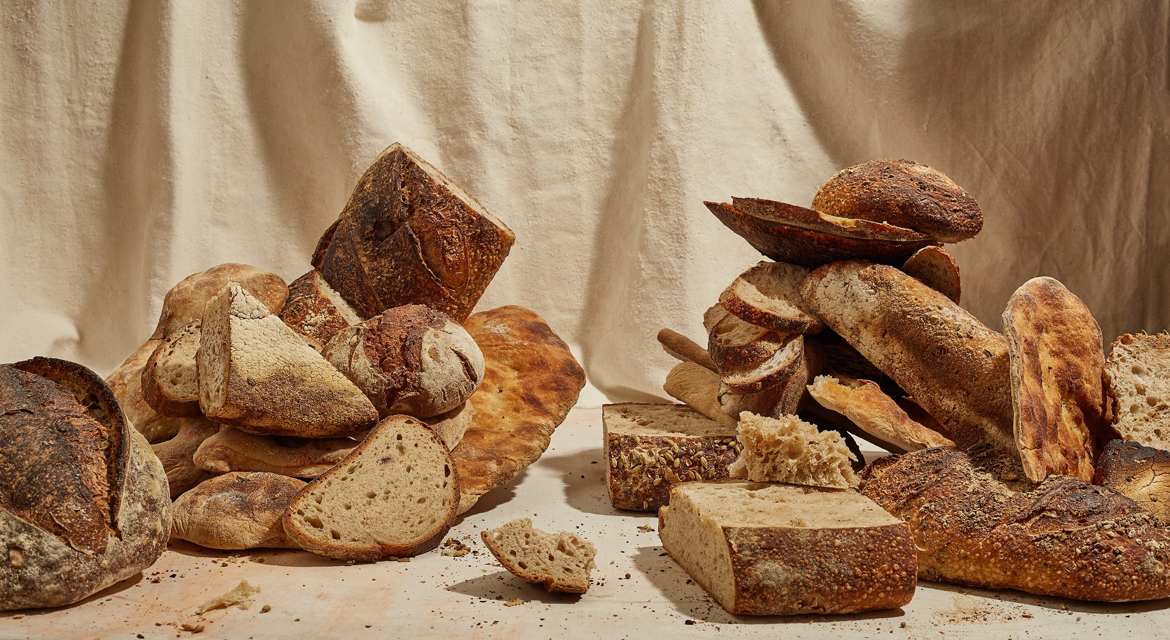
The two masters and the one not
BakeWise
Eliza Marija Kraule
Sarah Cherian
Ian Jiang

Slide 2
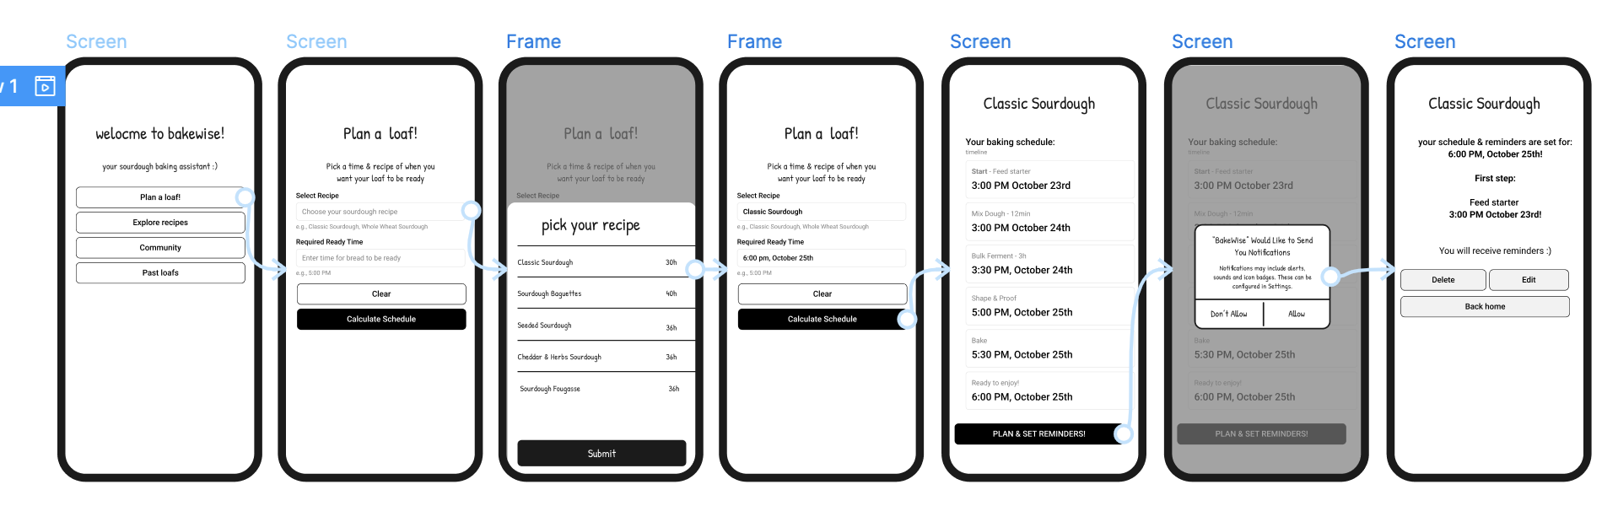
User tasks
User tasks 1 - Planning a loaf
Notes:
Initial State: The user has completed the dough kneading action, and a 15-minute timer is running within the app.
User Decision Point: The user now has two primary choices:
Option 1 (Active Learning): If the user wishes to use the waiting time to learn or view the next step, the app provides the corresponding entry point.
Option 2 (Passive Waiting): Users may continue waiting for the timer to complete, with the timer interface remaining visible.
Learning and Return: If users choose to learn, the app displays relevant content. Regardless of duration, users ultimately return to the timer interface to await completion.
Timer Ends: When the timer reaches zero, the app immediately provides a clear prompt and a distinct action button guiding the user to the next baking stage.
Proceed to Next Stage: After the user clicks the button, the app loads the interface for the next primary stage.
Recovery Guidance: Alert messages not only identify the issue but also provide clear recovery instructions (e.g., “Click here for a starter revival guide” or “Click here to learn how to pre-shape after a delay”).

Slide 3
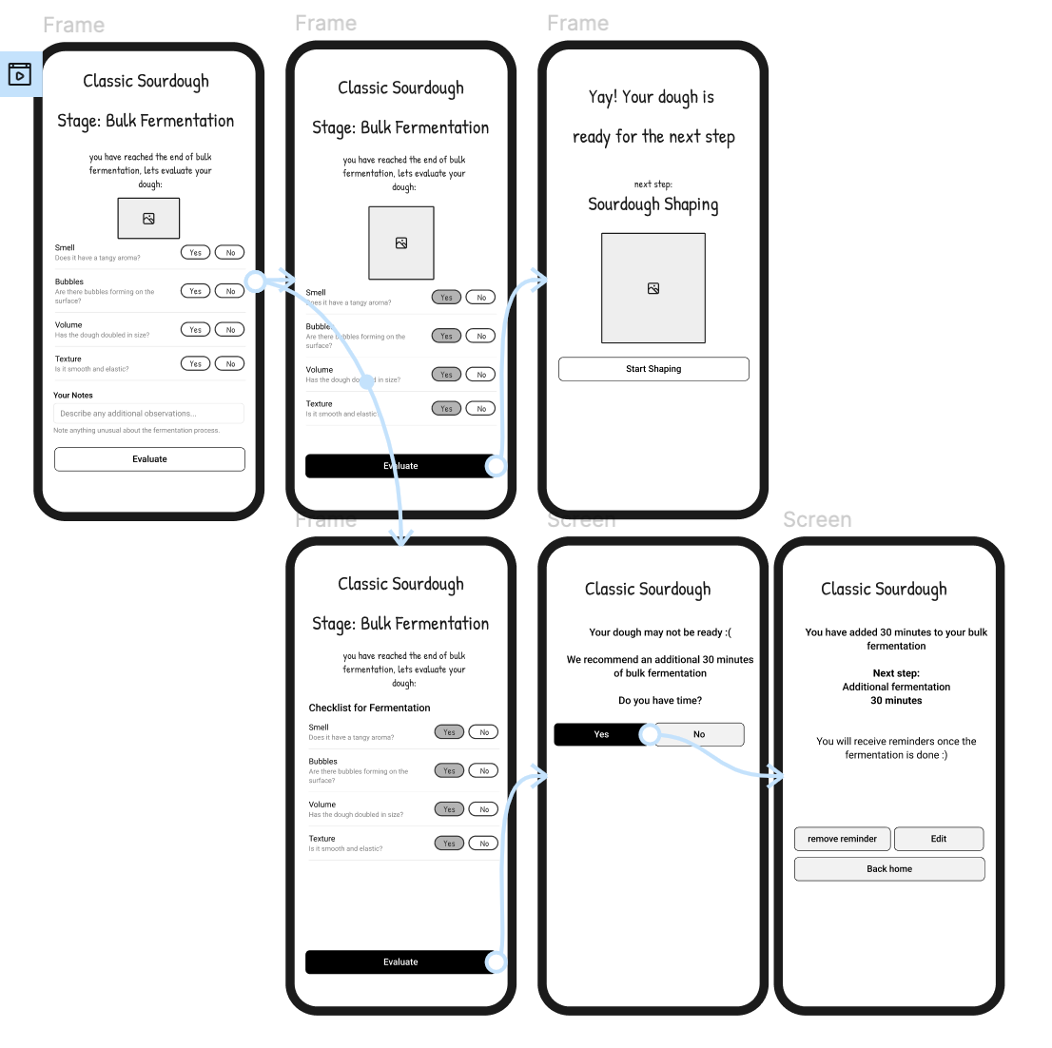
User tasks 2 - Fermentation Feedback
Notes:
So, the second core task we focused on is fermentation feedback, which tackles one of the biggest challenges for beginners — figuring out when the dough is actually ready - the idea is that instead of relying on a timer we are making a dynamic visual feedback system that helps users translate those vague sensory cues of - how the dough looks, smells, and feels → into clear, guided steps.
When users reach the fermentation stage, the app walks them through a checklist — things like checking dough elasticity, moisture, and aroma. It’s kind of like having a baking coach right there with you, helping you assess what’s happening.
Based on what the user observes, the app gives personalized recommendations — maybe suggesting a bit more fermentation time if the dough’s still dense, or confirming it’s ready to move to shaping.
The idea is to prevent mistakes early where one small error early on ruins everything later. It also helps users learn over time — they start to trust their own senses instead of just the timer.
And for anyone who’s still unsure, there’s a Community Insights option where they can see what others observed at the same stage or ask for quick advice.
Overall, this feature turns fermentation from a confusing guessing game into a guided, confidence-building step — helping bakers feel in control

Slide 4
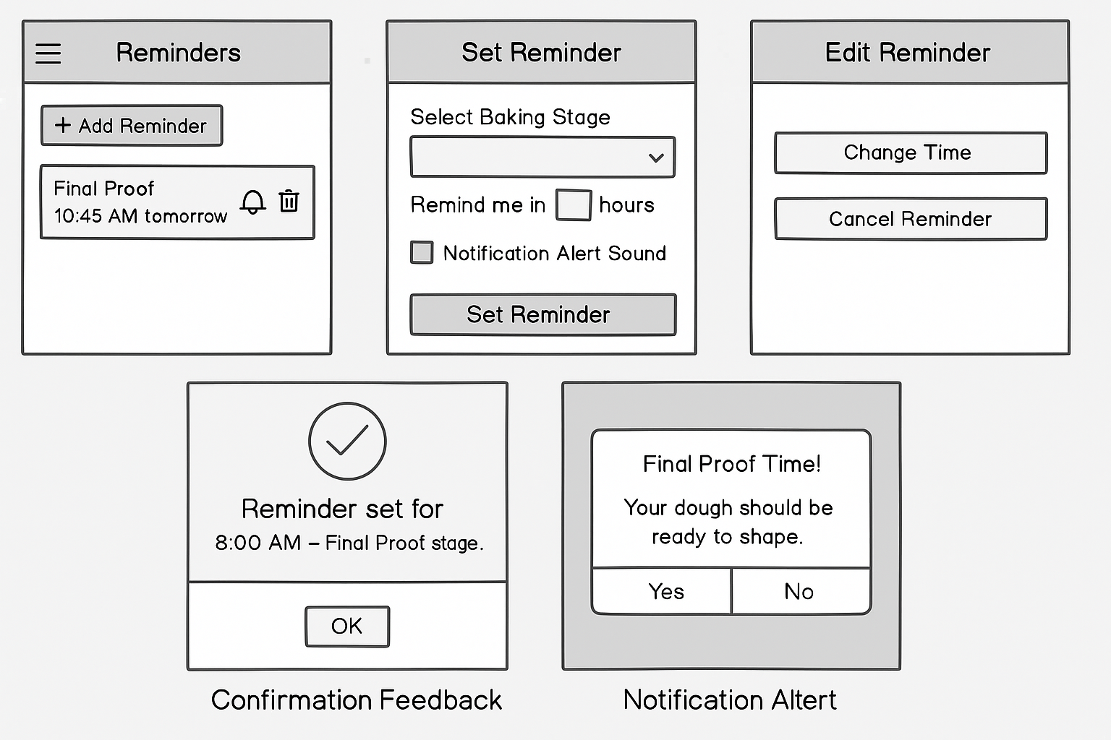
User tasks 3 - Reminder
Notes:
Scenario 1: User Sets Reminder (Error Prevention)
User Action: When guiding users through fermentation in the app, the interface prominently displays a “Set Reminder” option.
App Response: Upon user click, the app displays a concise settings window allowing users to select a reminder time or automatically recommends reminders based on the current step.
App Confirmation: After successfully setting the reminder, the app provides brief confirmation feedback

Slide 5
Figma Link - BakeWise Low fidelity prototype

Slide 6
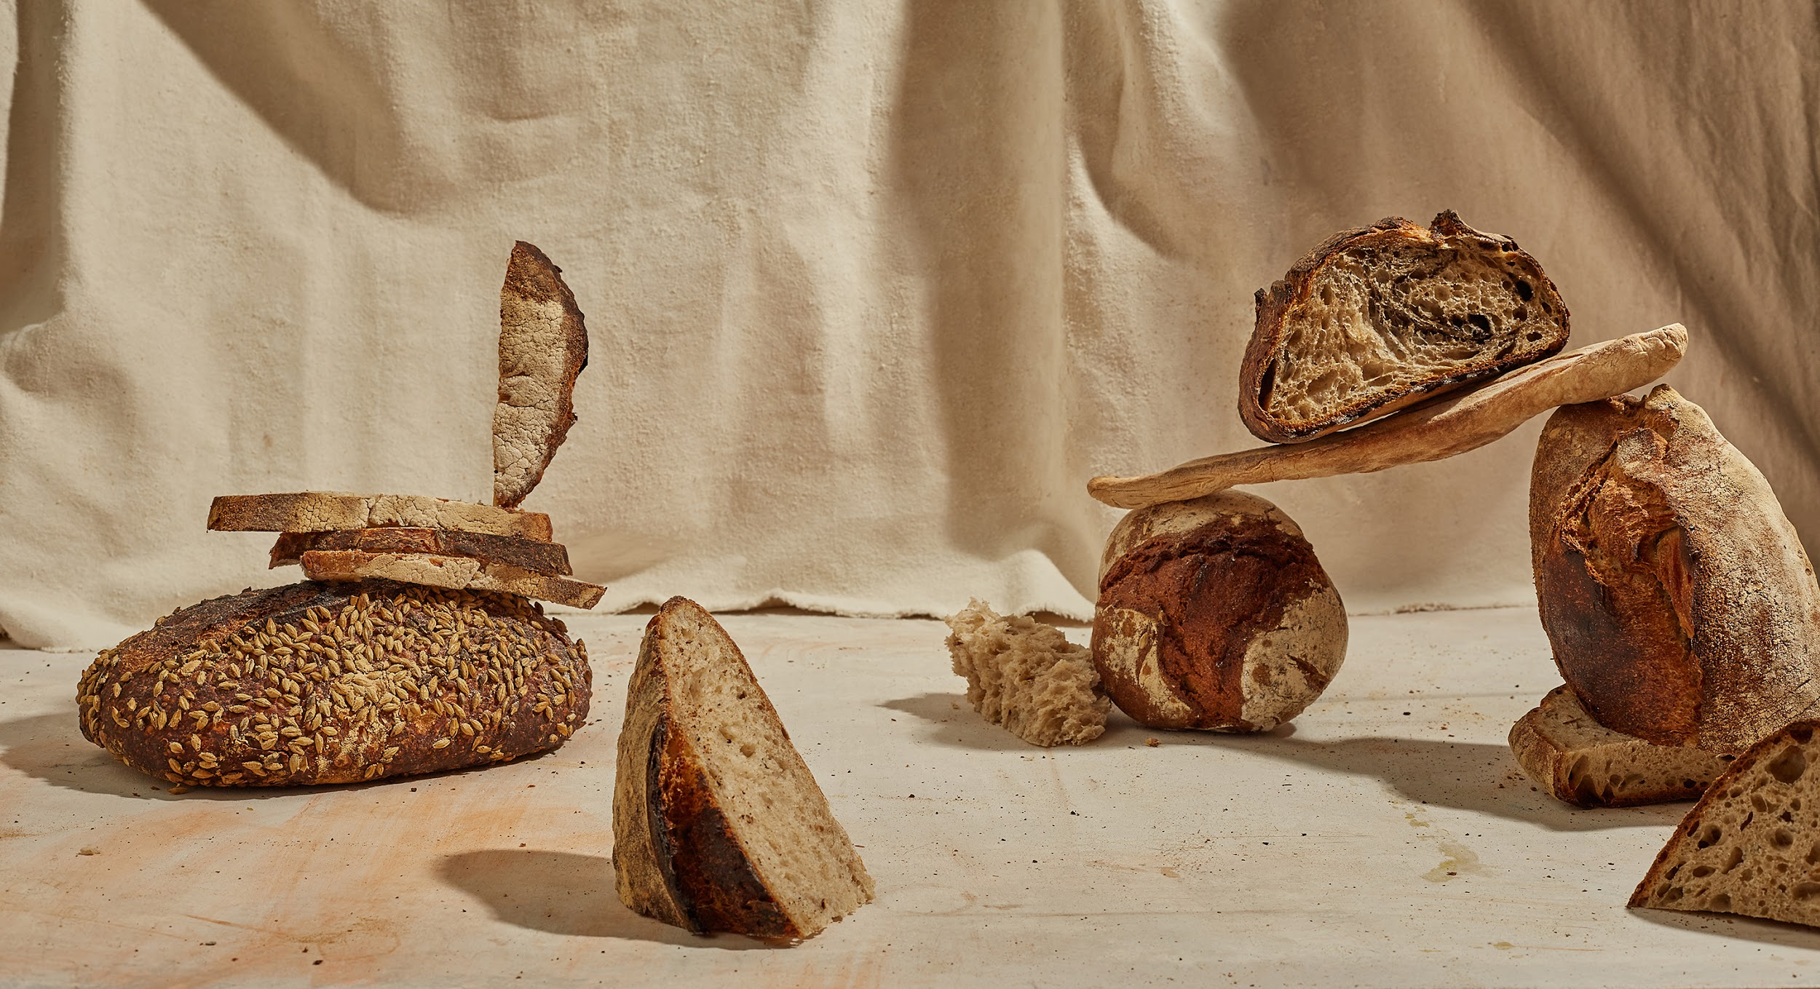
Thank you for your time!
Notes:
You will perform a peer evaluation for every deliverable in the course. The reason is that we want you to receive early and consistent opportunities to communicate any issues with the instructors and provide valuable feedback to your team members about how they’ve been contributing to the project. Please be as honest as possible. The peer rating form for the initial proposal will be released tomorrow after the proposal deadline and is due 11:59 pm on Monday.

